Slide 1
SECURITY HARDENING – SOFTWARE APPLICATIONS
Two types of security hardening:
IT assets (systems, network devices, databases, applications)
Software developed internally or by third party

Slide 2
SECURITY HARDENING – SOFTWARE APPLICATIONS
Typical enterprise software:
ERP (Oracle, SAP, IBM, etc)
Internally or 3rd party developed software in ASP.NET, PHP, Android/IOS, or other platform

Slide 3
SECURITY HARDENING – SOFTWARE APPLICATIONS
8 STEP SECURITY HARDENING METHODOLOGY
1. Identify critical assets (& asset owner)
2. Research on applicable security controls
3. Checklist of applicable controls
5. Implement controls on test setup
4. Document controls into SOP
6. Validation of control implementation
7. Change management process for PROD
8. Implement on PROD & monitor

Slide 4
SECURITY HARDENING – SOFTWARE APPLICATIONS
1. Research Security Controls
2. Apply Security Controls (Hardening)
3. Code Review & Automated Testing (Validation)
4. Harden Server Environment
5. Pen Test & Accreditation
(Move to PROD)
SOFTWARE SECURITY
WORKFLOW

Slide 5
SECURITY HARDENING–SOFTWARE APPLICATIONS
Useful resources:
www.OWASP.org
www.cloudsecurityalliance.org
MS Technet
OWASP Top 10
OWASP Secure Coding Practices Quick Reference Guide
SAMM

Slide 6
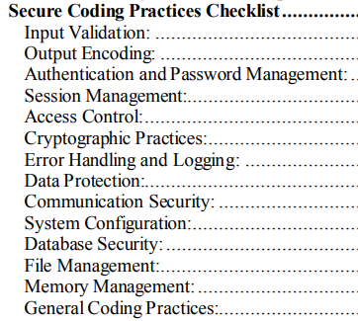
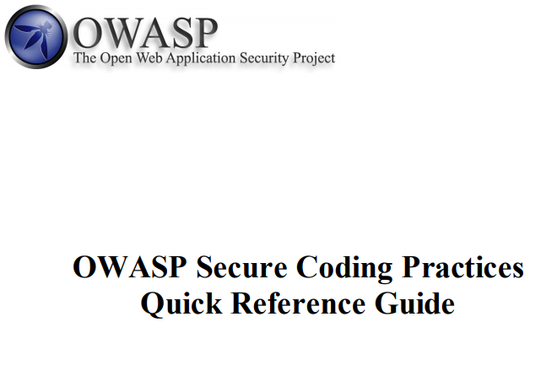
SECURITY HARDENING–SOFTWARE APPLICATIONS
17 pages document

Slide 7
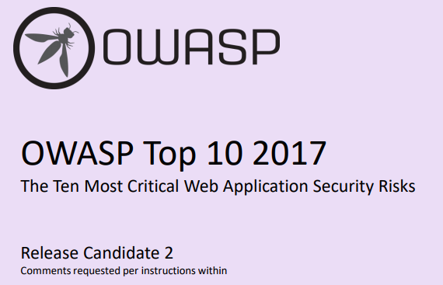
SECURITY HARDENING–SOFTWARE APPLICATIONS
Latest version is currently under review

Slide 8
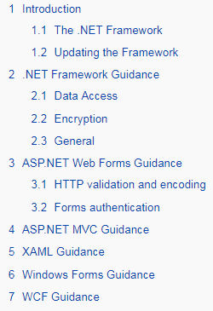
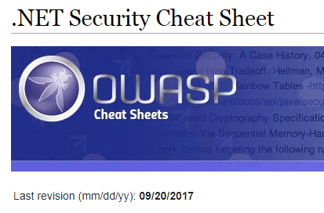
SECURITY HARDENING–SOFTWARE APPLICATIONS
Latest version 20 SEPT ‘17

Slide 9
SECURITY HARDENING–SOFTWARE APPLICATIONS
Conclusion
Software security hardening is a challenging activity
Build software security program & integrate with QA
Domain specific knowledge required
Build capabilities and process following SAMM
END

